Slide 1

Project Report - Microsoft Fabric and Power BI
Submitted by Usama Yazdani | Data Analytics Intern

Slide 2
Agenda
Microsoft Fabric - Bing News Data Analytics Project
Power BI - Data Professional Survey Breakdown
Key Insights
Conclusion & Next Steps

Slide 3
Microsoft Fabric Project Overview
Project Objective:
Analyze news data using Microsoft Fabric, starting from data ingestion to creating interactive reports in Power BI.
Tools Used:
Microsoft Azure, Bing News API, Synapse, Power BI
Steps:
Data ingestion, storage, transformation, and reporting

Slide 4
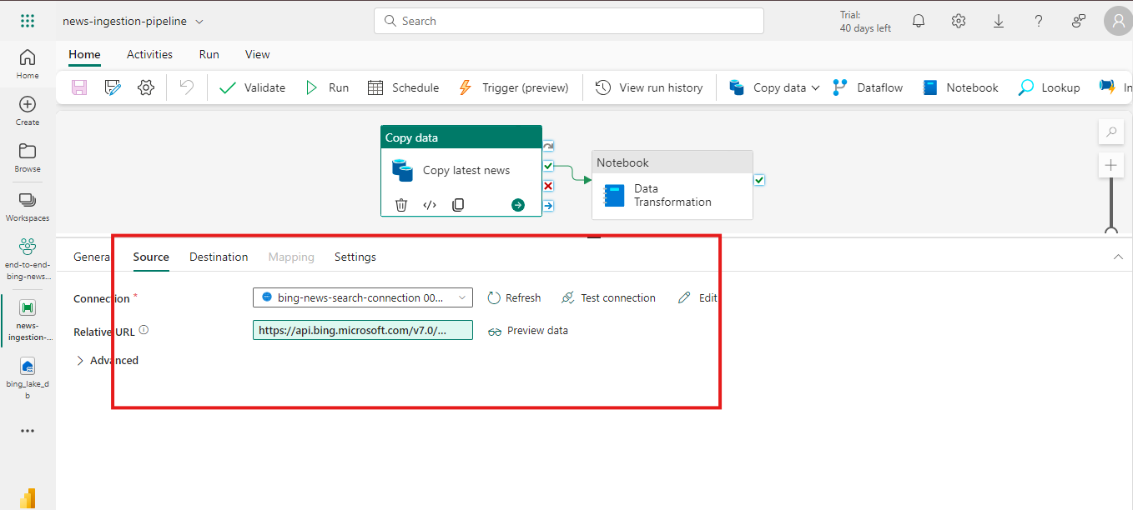
Data Gathering Process
Bing News API: Used to retrieve real-time news data.
Data was stored in JSON format and loaded into the Lakehouse (Microsoft Fabric).

Slide 5
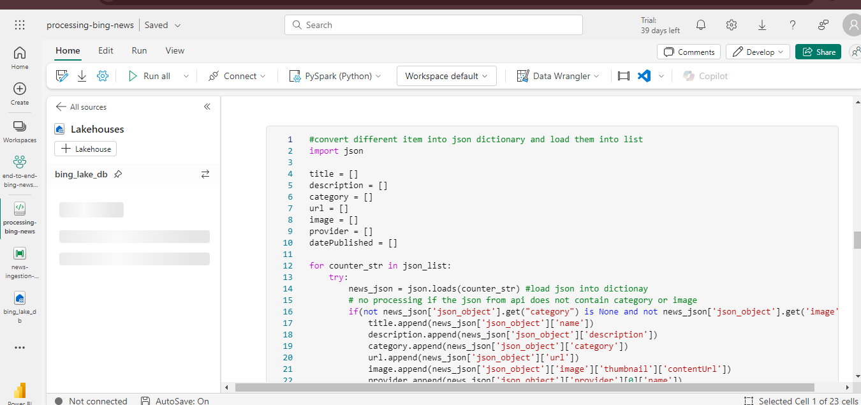
Data Storage and Preprocessing
Data Storage:
Lakehouse: A cloud-based storage in Microsoft Fabric used to store the JSON files.
Data Preprocessing:
Used Synapse Notebooks for data cleansing and transformations (PySpark).

Slide 6
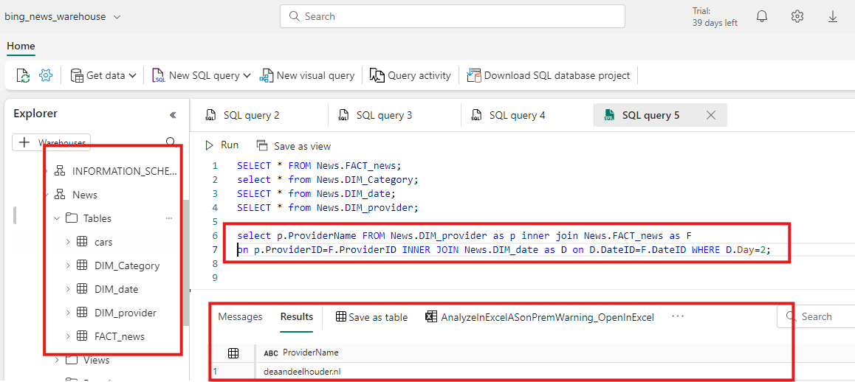
Data Transformation and ETL
Extracted data from Lakehouse, transformed it into meaningful dimensions and facts using TSQL.
Loaded the transformed data into a data warehouse for further analysis.
Key Focus: Ensuring the data was structured and ready for analysis in Power BI.

Slide 7
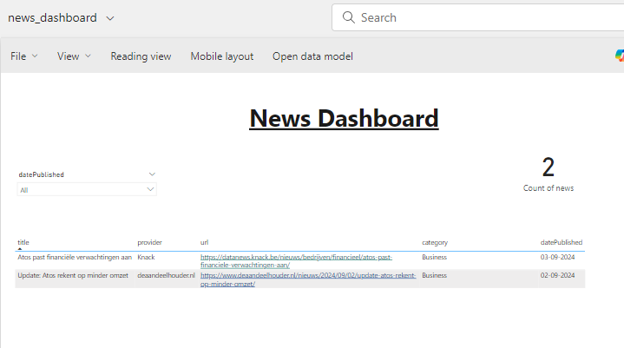
Power BI Integration
Connected the transformed data to Power BI for creating visualizations.
Built a semantic model to streamline the data for reporting purposes.

Slide 8
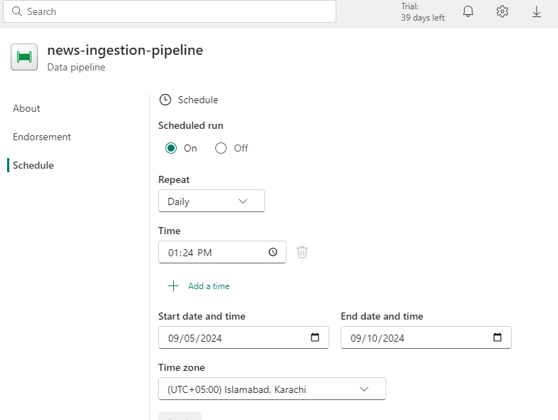
Automation with Microsoft Fabric
Used Data Factory in Microsoft Fabric to automate the data ingestion and transformation processes.
Data is fetched every hour and updated in the system without manual intervention.

Slide 9
Project 2 : Power BI - Data Professional Survey Breakdown

Slide 10
Project Objective :-
Analyzed survey data from 630 respondents to gather insights into the data professionals' demographics, skills, and job satisfaction
Key Data Points:
Country of Survey Takers
Average Salary by Job Title
Favorite Programming Language
Happiness with Salary & Work/Life Balance

Slide 11
Power BI Dashboard Overview
Treemap: Country of Survey Takers
Bar Chart: Average Salary by Job Title
Column Chart: Favorite Programming Language
Donut Chart: Difficulty to Break Into Data
Gauge Charts: Happiness with Salary and Work-Life Balance

Slide 12
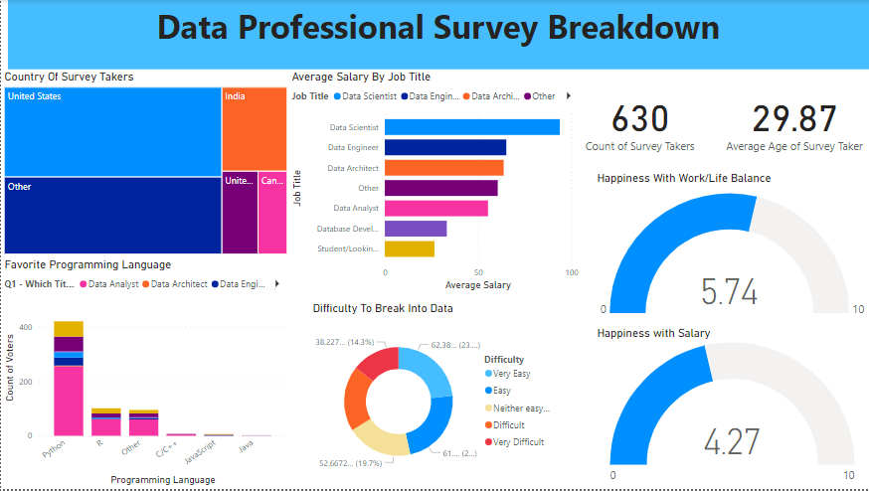

Slide 13

Thank You
Closing Remarks:
Thank you for reviewing the project report.
Looking forward to your feedback.
Contact Details:
Usama Yazdani, Data Analytics Intern
Email: usama.yazdani@systemsltd.com

